Slide 1

Cryptography

Slide 2
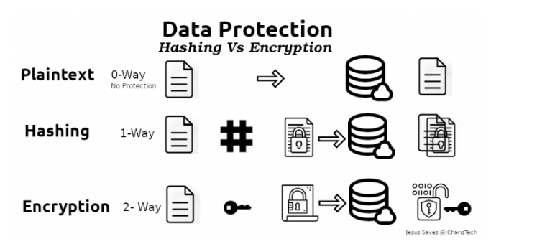
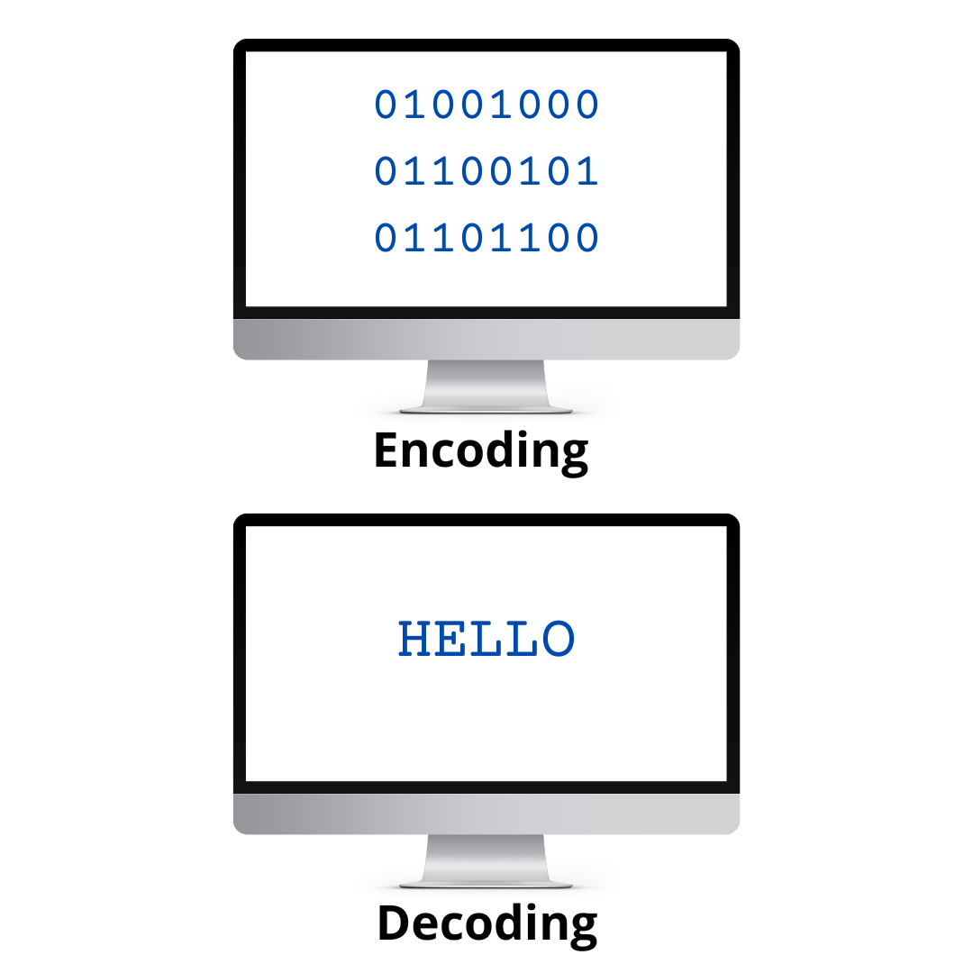
Encryption & Hashing & Encoding

Slide 3
Hashing, one-way function takes input data and produces a hash value, a fixed-size string of characters (digest). This hash value uniquely represents the data, and any change in the data, no matter how small, should lead to a change in the hash valueyou can’t reverse the process to get the original data.
Encryption is the process of securely encoding data in such a way that only authorized users with a key or password can decrypt the data to reveal the original. Encryption is used when data needs to be protected so those without the decryption keys cannot access the original data.
Encoding converts data from one form to another to make it compatible with a specific system. ASCII, UTF-8, UTF-16, UTF-32, ISO-8859-1, and Windows-1252 are valid encoding methods for the English language. Note that UTF-8, UTF-16, and UTF-32 are Unicode encodings, and they can represent characters from other languages, such as Arabic and Japanese.

Slide 4
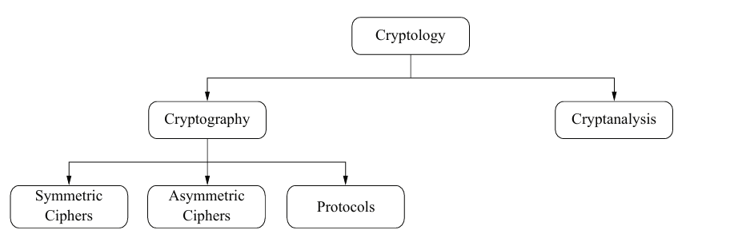
Cryptography is the science of secret writing with the goal of hiding the meaning of a message.
Cryptanalysis is the science and sometimes art of breaking cryptosystems.

Slide 5
protect confidentiality, integrity, and authenticity.
According to Payment Card Industry Data Security Standard (PCI DSS).should be encrypted and secured both while being stored (at rest) and while being transmitted (in motion).
when handling medical records include HIPAA (Health Insurance Portability and Accountability Act) and HITECH (Health Information Technology for Economic and Clinical Health) in the USA, GDPR (General Data Protection Regulation) in the EU, DPA (Data Protection Act) in the UK.

Slide 6
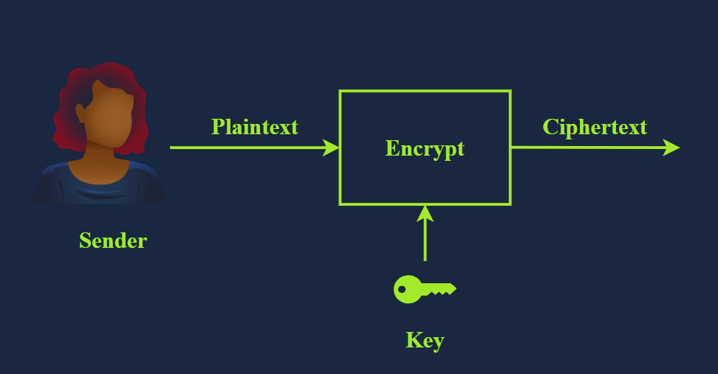
Plaintext to Ciphertext

Slide 7
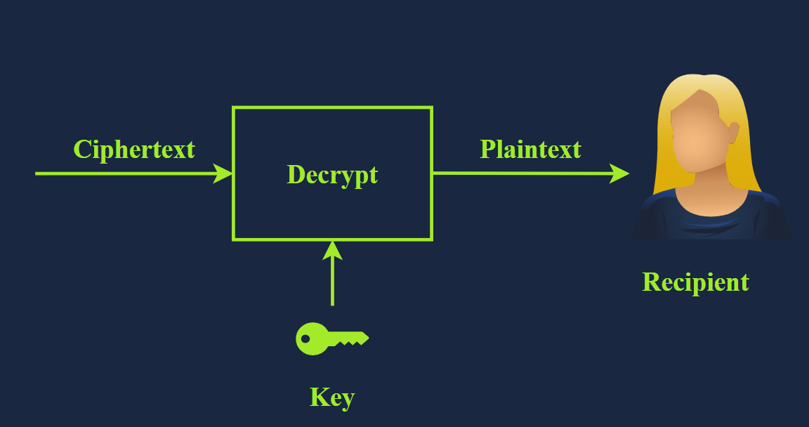
Ciphertext To Plain

Slide 8
Plaintext is the original, readable message or data before it’s encrypted.
Ciphertext is the scrambled, unreadable version of the message after encryption. Ideally, we cannot get any information about the original plaintext except its approximate size.
Cipher is an algorithm or method to convert plaintext into ciphertext and back again.
Key is a string of bits the cipher uses to encrypt or decrypt data. In general, the used cipher is public knowledge; however, the key must remain secret unless it is the public key in asymmetric encryption.
Encryption is the process of converting plaintext into ciphertext using a cipher and a key. Unlike the key, the choice of the cipher is disclosed.
Decryption is the reverse process of encryption, converting ciphertext back into plaintext using a cipher and a key. Although the cipher would be public knowledge, recovering the plaintext without knowledge of the key should be impossible (infeasible).

Slide 9
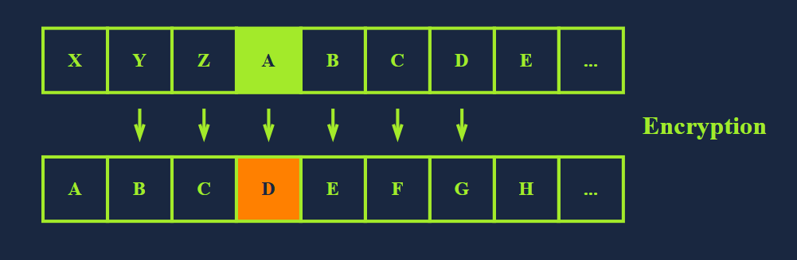
Cryptography’s history
back to ancient Egypt in 1900 BCE
Caesar
→ The idea is simple: shift each letter by a certain number to encrypt the message.
Plaintext: ALIMO
Key: 3 (Assume it is a right shift of 3.)
Cipher: Caesar Cipher
Ciphertext → DOLPR
25 valid keys for encryption with Caesar Cipher.
→ easy Break !! : https://cryptii.com/pipes/caesar-cipher and https://www.dcode.fr/caesar-cipher

Slide 10
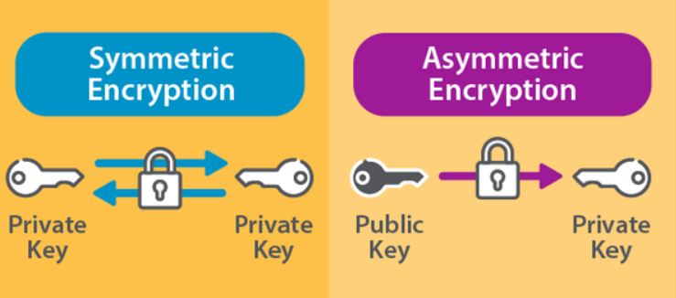
Types of Encryption

Slide 11
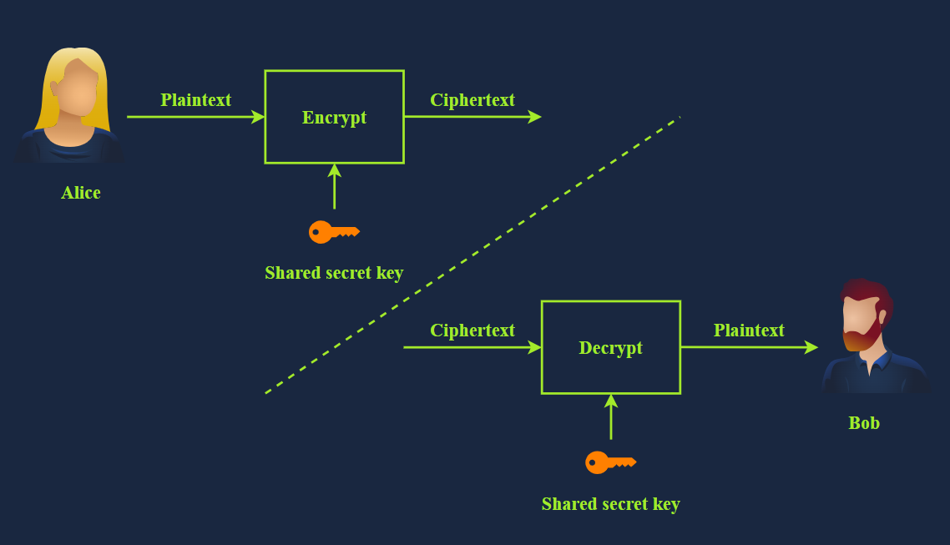
Symmetric Encryption
Known as
symmetric cryptography
or
private key cryptography
same key to encrypt and decrypt the data

Slide 12
Examples of symmetric encryption
DES (Data Encryption Standard) was adopted as a standard in 1977 and uses a 56-bit key. With the advancement in computing power, in 1999, a DES key was successfully broken in less than 24 hours, motivating the shift to 3DES.
3DES is DES applied three times; consequently, the key size is 168 bits, though the effective security is 112 bits. 3DES was more of an ad-hoc solution when DES was no longer considered secure. 3DES was deprecated in 2019 and should be replaced by AES; however, it may still be found in some legacy systems.
AES (Advanced Encryption Standard) was adopted as a standard in 2001. Its key size can be 128, 192, or 256 bits.

Slide 13
Can You define the Limitations!!

Slide 14
Remember
Authentication: You want to be sure you communicate with the right person, not someone else pretending (verifying identity).
Authenticity: You can verify that the information comes from the claimed source.
Integrity: You must ensure that no one changes the data you exchange.
Confidentiality: You want to prevent an unauthorised party from eavesdropping on your conversations.

Slide 15
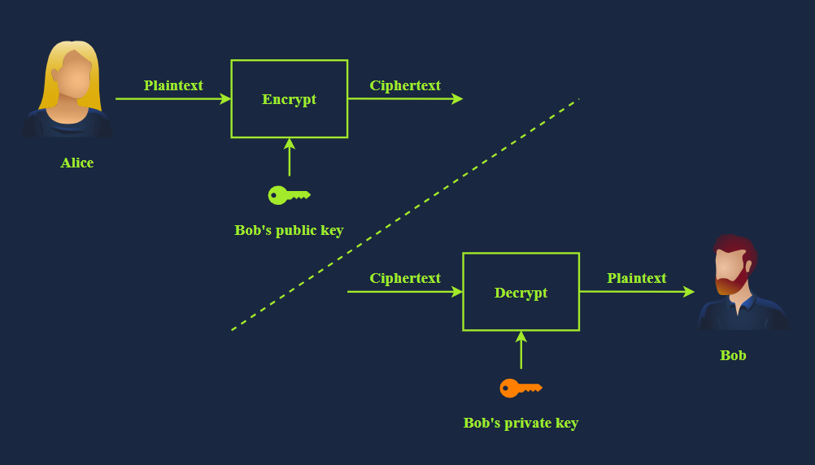
Public Key Cryptography (Asymmetric Encryption)
Exchanging keys for symmetric encryption
Non-repudiation
Authentication, Authenticity, Integrity, Confidentiality.
slow compared to symmetric encryption

Slide 16
Digital Signature
digital signature to refer to signing a document using a private key or a certificate.
verify the authenticity
Certificates: Prove Who You Are
The certificates have a chain of trust, starting with a root CA (Certificate Authority).
Certificates are trusted only when the Root CAs say they trust the organisation that signed them.
Explanation: the certificate is signed by an organisation, the organisation is trusted by a CA, and the CA is trusted by your browser. Therefore, your browser trusts the certificate. (see chrome CA that it Trust),
→ when a website and want to use HTTPS. This step requires having a TLS certificate. You can get one from the various certificate authorities.
( Let's Encrypt)

Slide 17
https://play.picoctf.org/practice/challenge/418?category=2&page=1
https://cybertalents.com/challenges/cryptography/postbase

Slide 18
RSA
Algorithm: RSA Key Generation Output:
public key: kpub = (n, e)
private key kpr = d
Choose two large primes p, q
Compute n = p * q
Compute Φ(n) = (p-1) * (q-1)
Select the public exponent e ε {1, 2, …, Φ(n)-1}
→ such that gcd(e, Φ(n) ) = 1
Compute the private key d such that d * e ≡ 1 mod Φ(n)
RETURN kpub = (n, e),
kpr = d
p and q are large prime numbers
n is the product of p and q
The public key is n and e
The private key is n and d
m is used to represent the original message, i.e., plaintext
c represents the encrypted text, i.e., ciphertext

